Slide 1
INTEGRATION BOOTCAMP
Integrating with Azure Serverless

Slide 2
What is the right size of
servers for my business needs?
How do I deploy new code to my server?
What media should I
use to keep backup?
What happens in case of
server hardware failure?
Which packages should be on my server?
What size of servers
should I buy?
Who monitors
my App?
How often should I backup my server?
How can I scale my app?
How can I increase server utilization?
Who has physical
access to my servers?
Which OS should I use?
Do I need secondary network connection?
Are my server in a
secure location?
What happens if the
power goes out?
Who monitors
my Servers?
Do I need a UPS?
What storage I need to use?
How many servers
do I need?
How can I dynamically configure my app?
It takes how long to provision a new server?
How often should
I patch my servers?
On-Premises
The “evolution” of application platforms
Notes:
All good things begin with a story.
So before I talk to you about serverless, I wanted to discuss some history of how apps have been built through the years and how that has led us to the computing options we have today.
Buy your own hardware and software
Run it in your own data-centers
Deal with a multitude of questions
# of servers
Physical security
Hardware failure
Software patching
Backup
Essentially a lot of questions, not all of which might be directly related to running your business. For example, if you are running an insurance company, you want to spend your time growing and innovating in the insurance domain, not worrying about how to handle servers.

Slide 3
What is the right size of servers for my business needs?
How can I increase server utilization?
How many servers do I need?
How can I scale my app?
How often should I patch my servers?
How do I deploy new code to my server?
How often should I backup my server?
Which OS should I use?
Which packages should be on my server?
Who monitors my App?
On-Premises
IaaS
The “evolution” of application platforms
Notes:
Along came the cloud, and provided some relief from some of those questions.
IaaS in the cloud, allowed you to forget about managing all that physical hardware. Instead of hosting it yourself, you could now utilize servers hosted by someone else. While the worries around managing physical infrastructure are gone, there are a number of questions that still need to thought about:
How many virtual machines do I need?
How many would I need in future when my usage grows?
How to handle updating the servers for the latest security patches
How to think about deploying my code and the various dependencies, such as application runtimes, to the server
Who monitors my apps and so on
This means that you still haven’t reached that ideal state where you could focus purely on your business and its problems.

Slide 4
What is the right size of “servers” for my business needs?
How can I increase “server” utilization?
How many “servers” do I need?
How can I scale my app?
On-Premises
IaaS
PaaS
The “evolution” of application platforms
Notes:
Well, the cloud continue to help with that problem and with the advent of PaaS, there was even more simplification. PaaS allows you to just worry about your app, and let the cloud vendor take care of not only the physical hardware, but also the ongoing management of the operating environment like Operating Systems, Virtual Machines or Containers, as well as the various application runtimes, whether it is Java Runtime, .NET, Node.js, and so on.
You are not completely free from thinking about servers however, since you still have to worry about how to scale your app and accordingly specify the number and size of the various compute resources your apps would need at various times.

Slide 5
How do I architect my app?
Serverless, the platform for next gen apps
On-Premises
IaaS
PaaS
Serverless
The “evolution” of application platforms
Notes:
The latest in this series of evolution is Serverless – which further abstracts the underlying infrastructure from you, and allows you to focus only on a single question – how are you going to build your app to achieve the best results for your business, or whatever it is that you are trying to do with your apps.
Whether it is the code to delight your customers through a great experience, or the logic to communicate securely with a business partner, that is where most organization want to spend their creative energies on.
And serverless allows you to do just that, focus on your code and forget about the infrastructure.
This is why we believe it is the platform for next generation of apps.

Slide 6
What is Serverless?
$
Abstraction of servers
Event-driven/ instant scale
Micro-billing
Notes:
Abstraction of servers:
Complete freedom from thinking about provisioning, maintaining or scaling any server or infrastructure aspects
Event-driven/instant scale:
Ability to handle any volume of traffic without explicit configuration
handle sudden jump from 0 execution to tens of thousand of executions seamlessly
Micro-billing:
Paying only for what you use
You pay only for the amount of time your code runs and the amount of resources it consumes during that period
Never pay for idle capacity

Slide 7
Benefits of Serverless
Manage apps not servers
Reduced DevOps
Faster time to market
Notes:
Manage apps not servers:
Focus on your app logic. If you are an insurance company, you want to be spending your time on providing a great customer experience and maybe optimizing the claims approval process.
You don’t want to worry about servers. It is now possible
Reduced DevOps:
Since you are no longer required to worry about scale, availability, deployment etc., your effort towards non-core activities goes down significantly
Serverless architecture leads you down something we call a “pit of success” by providing a model where components are small and decoupled by design thereby reducing integration challenges
Faster time to market:
Time saved leads to faster app building
Serverless also provides an easy and cheap way to do experimentation – thereby allowing for faster iterations and prototypes

Slide 8

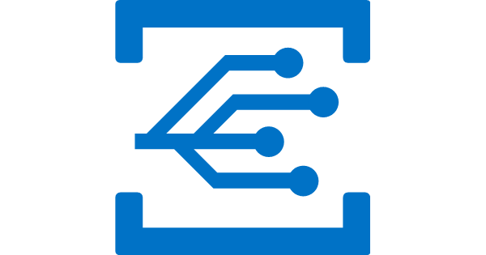

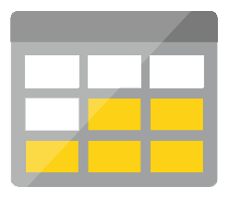
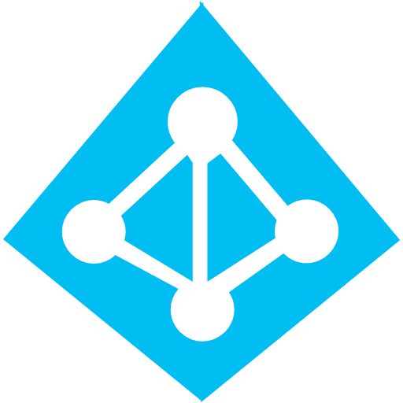
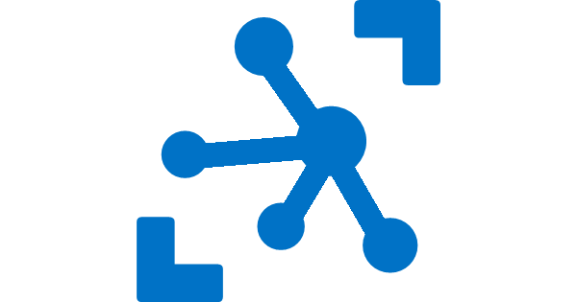
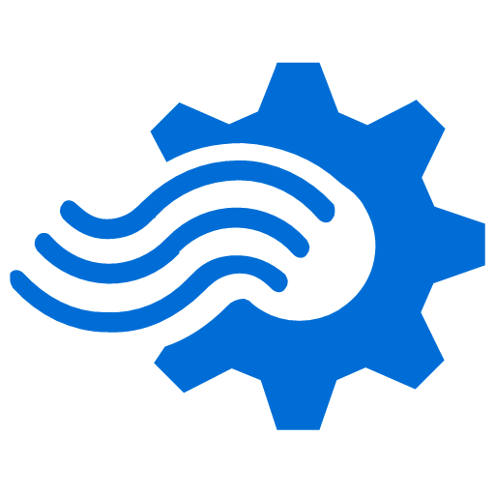
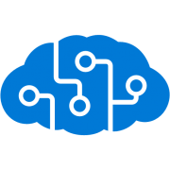
Serverless application platform components
Development
Platform
IDE support
Functions
Logic Apps
Event Grid
Execute your code based on events you specify
Design workflows and orchestrate processes
Manage all events that can trigger code or logic
Integrated DevOps
Local Development
Monitoring
Database
Storage
Security
IoT
Analytics
Intelligence
Visual Debug History
Notes:
Lets talk about what really makes up MSFT’s Serverless platform: At the center of the Serverless platform, is our compute offerings: Azure Functions and Azure Logic Apps. Azure Functions is an event based Serverless compute experience that helps you accelerate your development. Logic Apps is a powerful orchestration tool. It enables building a Serverless app in minutes – by orchestrating multiple functions using a visual workflow tool.
Say you have your apps up and running using Serverless. Congratulations! You now need to collect intelligence from different apps across platforms to take actions upon. There are a few essential components which we think are core to building Serverless applications are:
Data/ Storage –Functions has triggers and bindings with Azure document DB and Azure Blob storage
** Triggers: Triggers are event responses used to trigger your custom code. They allow you to respond to events across the Azure platform or on premise.
** Bindings: Bindings represent the necessary meta data used to connect your code to the desired trigger or associated input or output data.
Messaging such as queues and topics using Azure Service Bus and Azure Event Hubs
Integration – that includes core LOB apps and SaaS apps integration via Azure Logic Apps.
Intelligence on data and sentiment/ predictive analysis using Cognitive services and Machine learning
Conversation as a service – how do we equip developers to build apps that offer an end-to-end experience for their end users – Azure Bot Service offers a Serverless interactive bot experience.
More, developers are spending more time writing code that allows them to add huge business impact with Serverless. MSFT offers numerous development tools such as IDE Support for Visual Studio in functions and Logic Apps, enables local development (vs web browser coding environment), visual debugging capability, all with your tools of choice.
Lastly, I also want to highlight top scenarios and use cases for Serverless:
Real-time Stream analytics: Customers can use Functions to feed real-time streams of data from application tracking into structured data and store it in SQL online.
SaaS event processing: Customers can use Functions and Logic Apps to analyze data from an excel file in Onedrive and perform validation, filtration, sorting and convert data into consumable business charts
Web app architecture: Used a lot in creating targeted marketing collaterals – when a customer clicks on a webpage, it triggers a webhook, that uses a function to create an ad that matches the customer profile and displays a completed webpage.
Real-time bot messaging: When customers send a message to a chatbox, Functions calls Cortana analytics to generate appropriate answers and sends a response back.
//from before: Customers have different paths to build a Serverless app – start by building the distributed application components using functions by leveraging the numerous templates and declarative bindings Or
Start with the workflow and orchestration of Serverless application using Azure Logic Apps. The visual designer enables developers to quickly and easily author, edit and visualize orchestration of multiple functions and workflow.

Slide 9
Demo

Slide 10
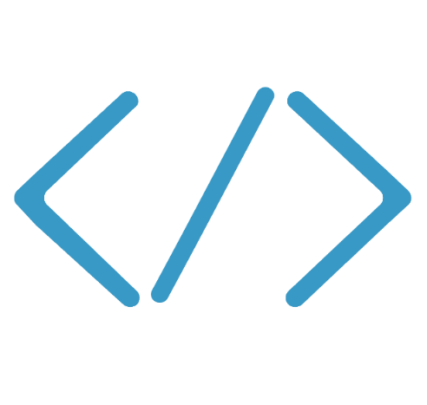

Functions
Code
Azure Functions
Events & Data
Develop locally using best of class developer tools
Boost productivity through triggers and bindings
Choose from a variety of programming languages
Integrate with existing DevOps processes

Slide 11
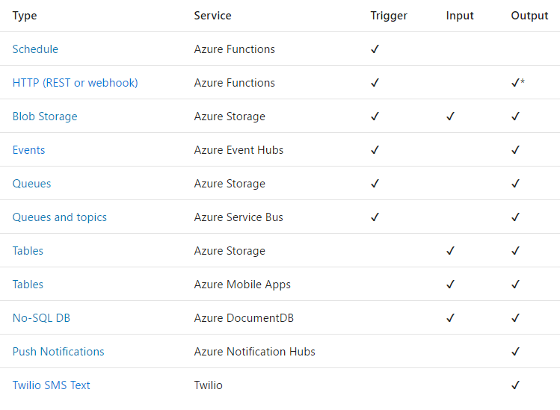
Functions triggers and bindings

Slide 12
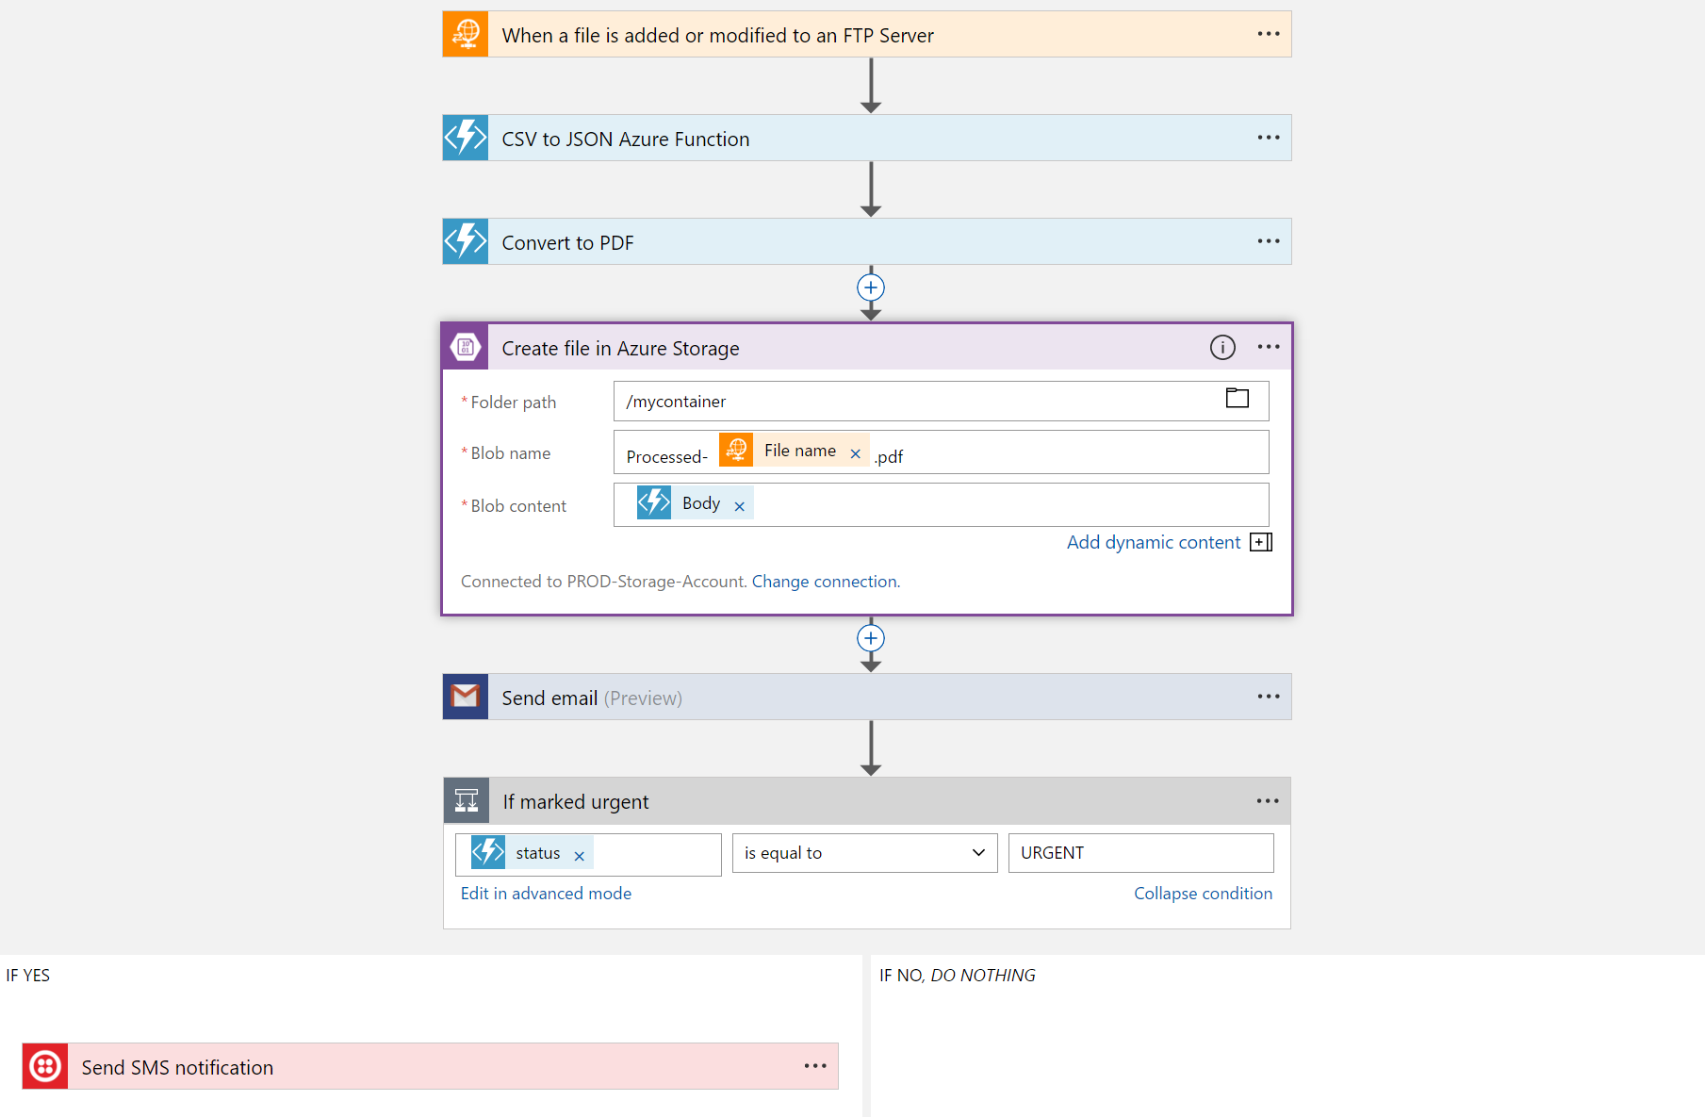
Logic Apps
Visually design workflows in the cloud
Express logic through powerful control flow
Connect disparate functions and APIs
Utilize declarative definition to work with CI/CD
Notes:
Up to 3 min
Powerful Integration and Workflow Engine born in Azure
- Fast integrations using a visual designer and workflow creation with triggers and actions
- Connect applications, data and services
- Connect and orchestrate Azure Functions

Slide 13
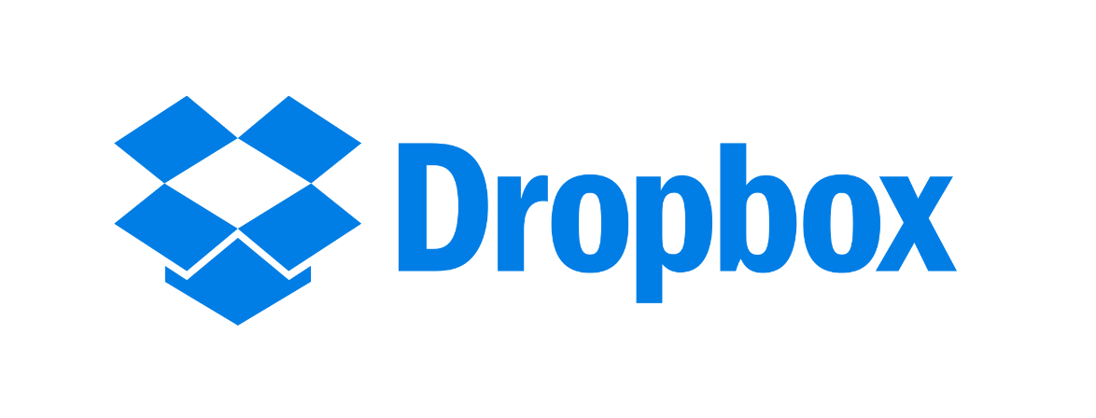

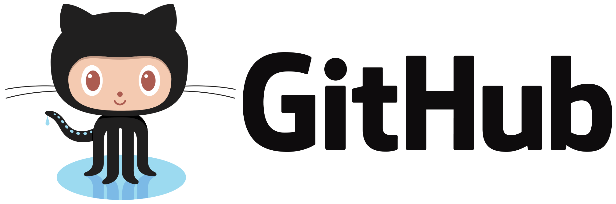
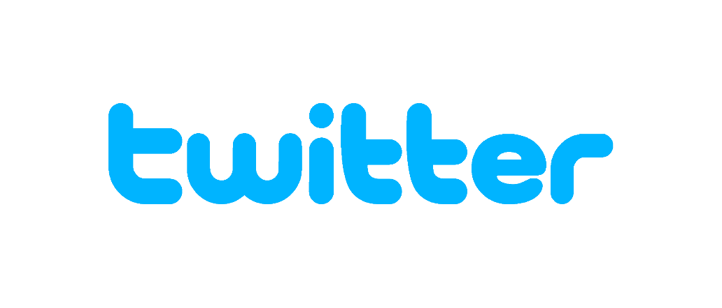
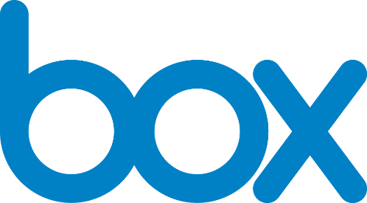

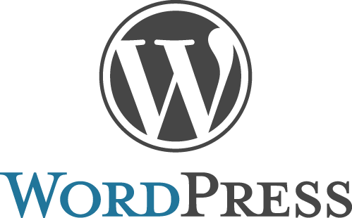
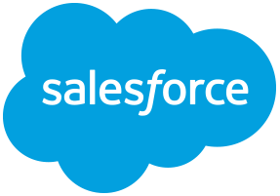
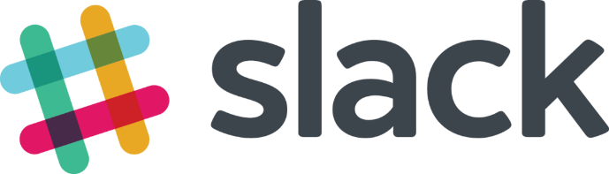
Logic Apps connectors—Over 170 and growing
….and more!

Slide 14

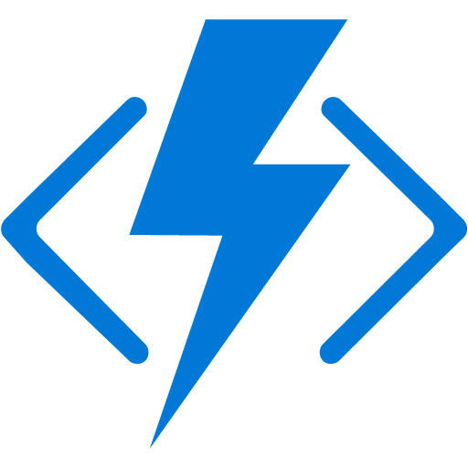
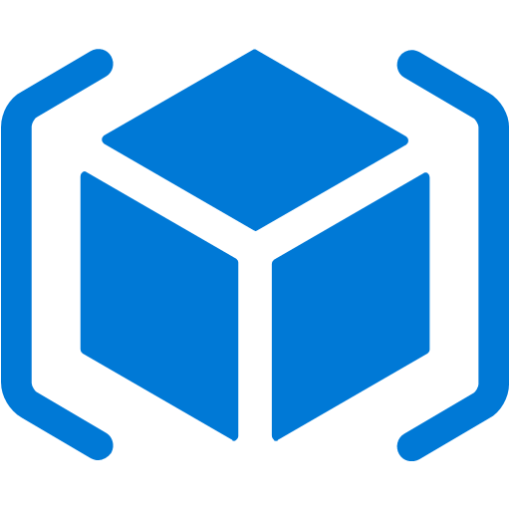

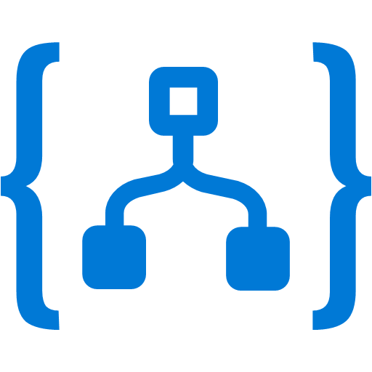


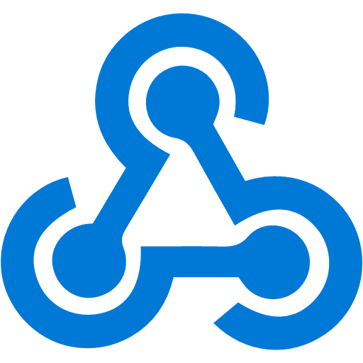

Event Grid
Event publishers
Event handlers
Manage all events in one place
Ensure reliability and performance for your apps
Unlock new scenarios for your apps
Blob Storage
Azure Functions
Resource Groups
Logic Apps
Azure Subscriptions
Azure Automation
Event Hubs
WebHooks
Custom Events

Slide 15
Event Grid delivers at massive scale
Sub-second end-to-end latency in the 99th percentile
10,000,000 events per second per region
24-hour retry with exponential back off for events not delivered
Near real-time
Massive scale-out
High reliability

Slide 16
When to use what?
Service Bus
Event Grid
Event Hubs
Relay
z
MESSAGES: Carry information that “pass the baton”
EVENTS: Carry information that “inform”
Service Bus: Message broker – cloud “transactions”, “at-least” guarantees
Event Grid: Distribution of events to consumers. Low-latency, low-friction, stateless events
Event Hub: Event “ingestor” – maintains state for multiple consumers to consume forwards/backwards as needed

Slide 17

Thank you for joining us.
© 2016 Microsoft Corporation. All rights reserved. Microsoft, Windows, Windows Vista and other product names are or may be registered trademarks and/or trademarks in the U.S. and/or other countries.
The information herein is for informational purposes only and represents the current view of Microsoft Corporation as of the date of this presentation. Because Microsoft must respond to changing market conditions, it should not be interpreted to be a commitment on the part of Microsoft, and Microsoft cannot guarantee the accuracy of any information provided after the date of this presentation. MICROSOFT MAKES NO WARRANTIES, EXPRESS, IMPLIED OR STATUTORY, AS TO THE INFORMATION IN THIS PRESENTATION.

